Slide 1
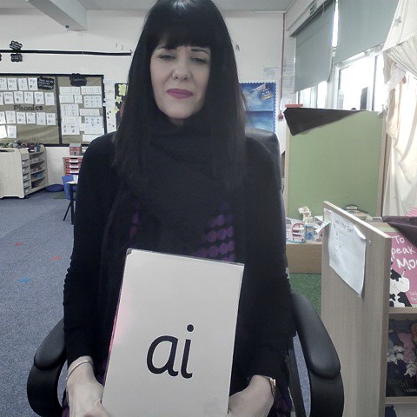
Phase 3 Song

Slide 2


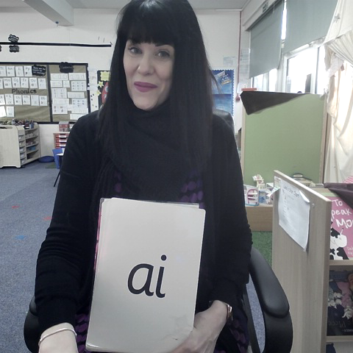
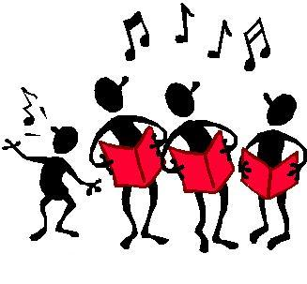
We can sing all our sounds.
Join in with our sound song.

Slide 3

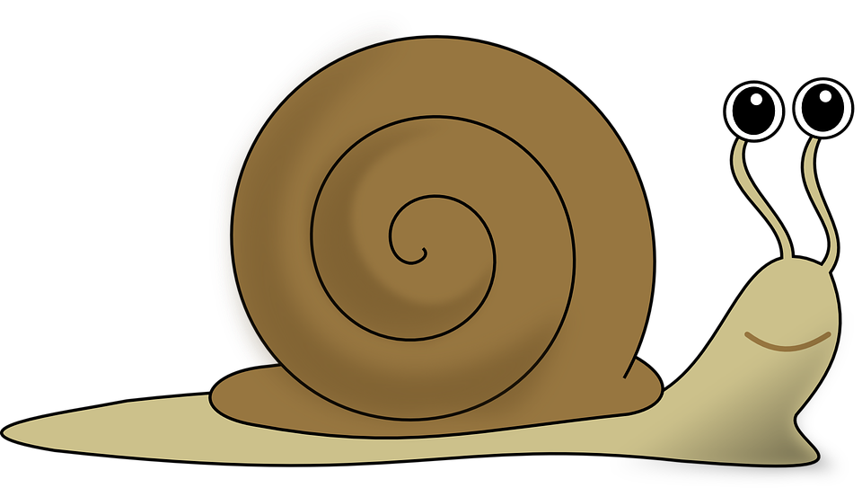
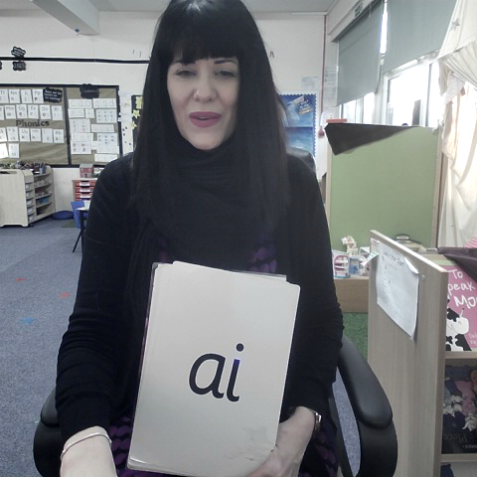
ai
Snail in the rain
Action: Twinkle fingers like rain coming down

Slide 4
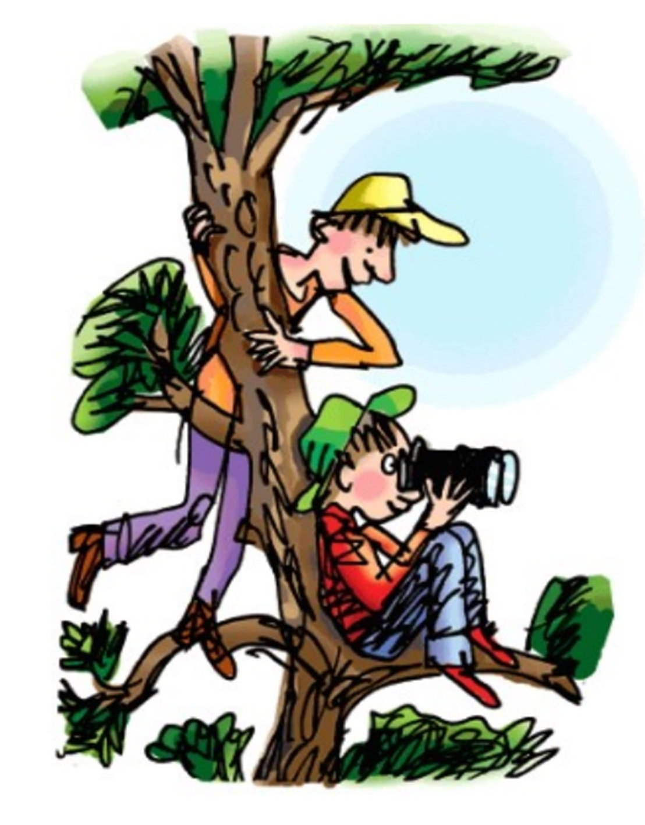
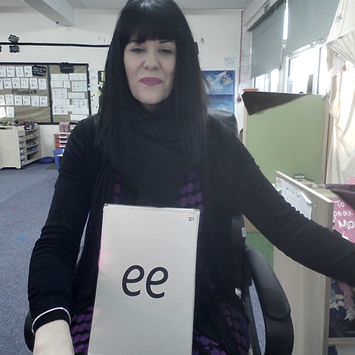
ee
What can you see?
Action: Hold hands up like you are looking through binoculars.

Slide 5
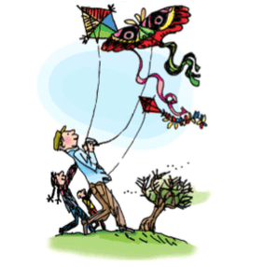
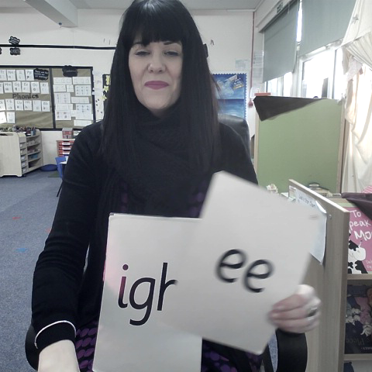
igh
Fly high
Action: wave arm around like it is flying.

Slide 6
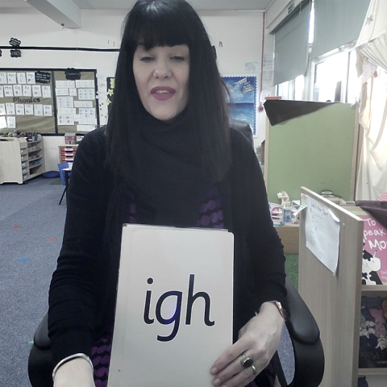
Join in with our sound song.

Slide 7
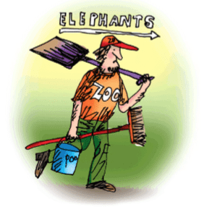
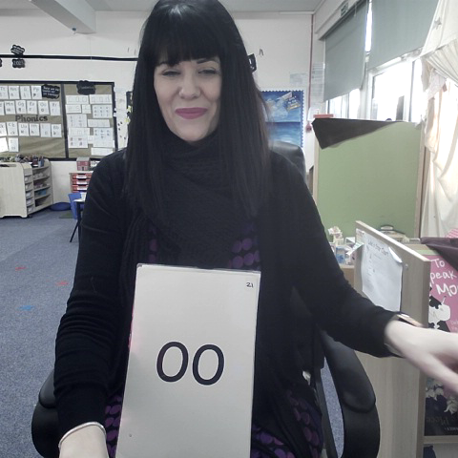
oo
Poo at the zoo
Action: hold something like it smells!

Slide 8
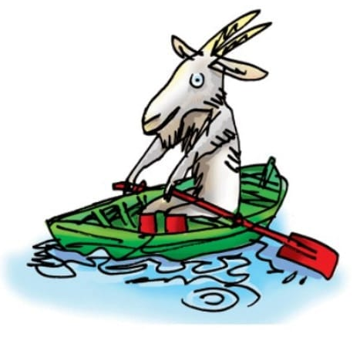
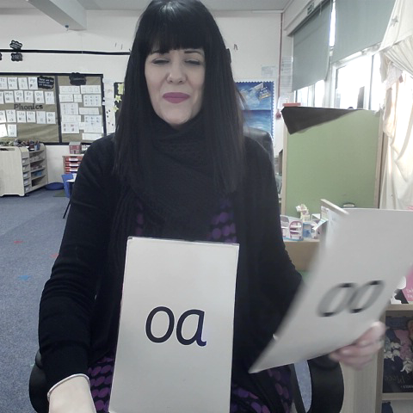
oa
Goat in a boat
Action: row a boat

Slide 9
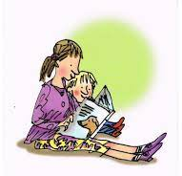
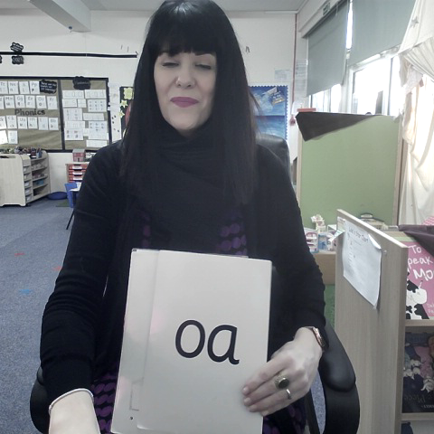
oo
Look at a book
Action: use hands to open a book.

Slide 10
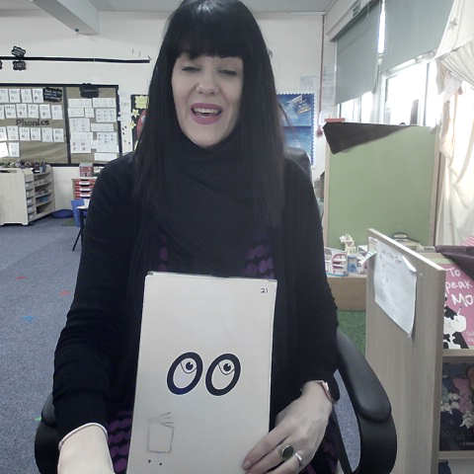
Join in with our sound song.

Slide 11
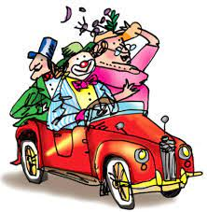
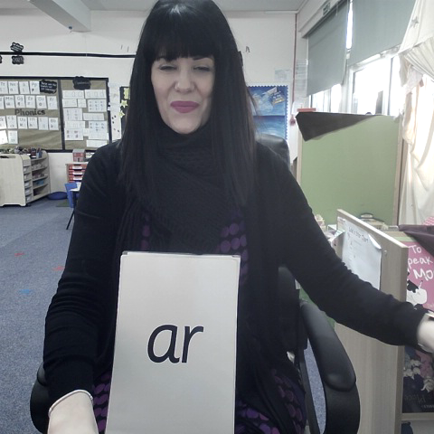
ar
Start the car
Action: pretend to drive the wheel of the car.

Slide 12
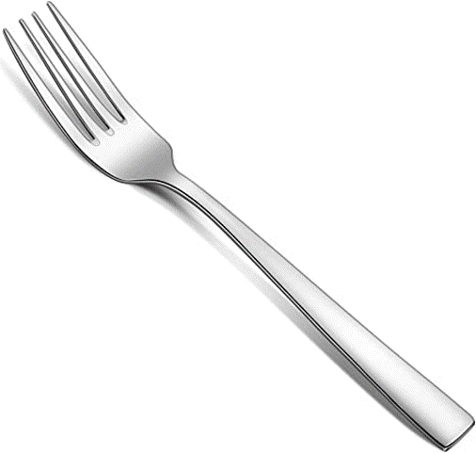
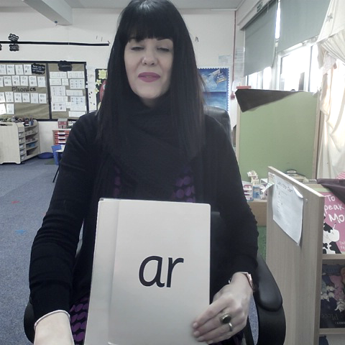
or
Knife and fork
Action: use two fingers on each hand as though eating

Slide 13

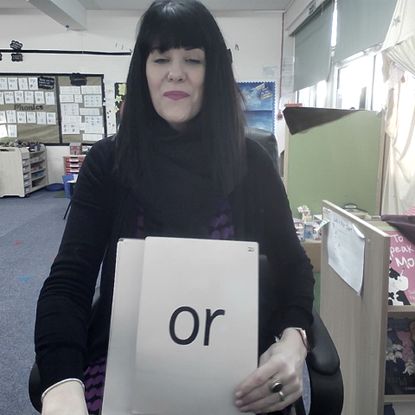
ur
Nurse with a purse
Action: make a cross on your shoulder with your thumb

Slide 14
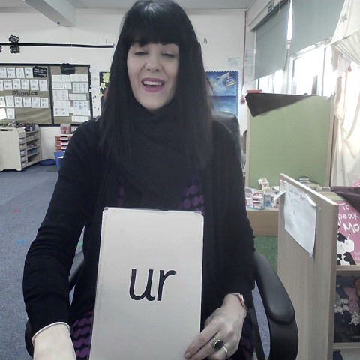
Join in with our sound song.

Slide 15
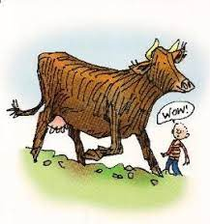
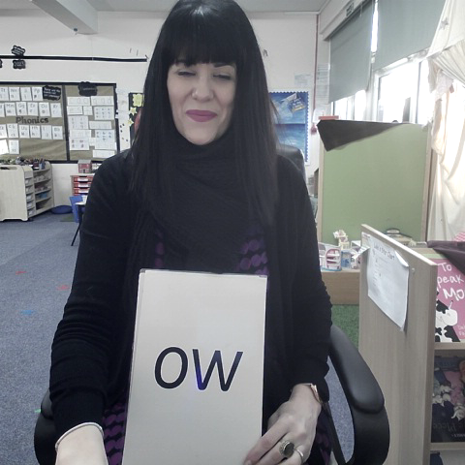
ow
Brown Cow
Action: make horns like a cown on your head

Slide 16

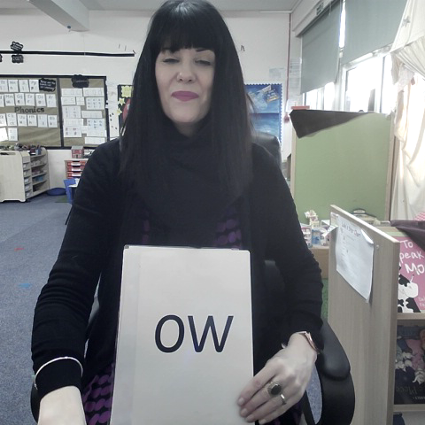
oi
Coin in the Soil
Action: Hold fingers in a circle.

Slide 17

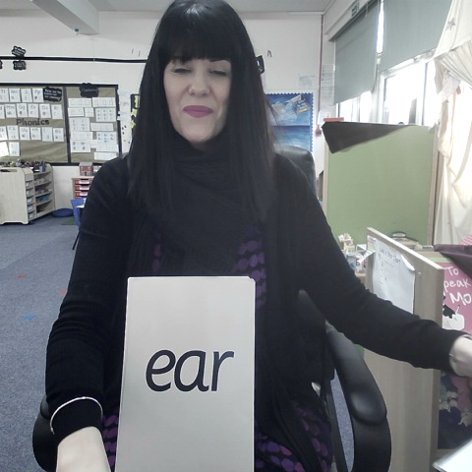
ear
Hear with your ear
Action: cup hand around your ear like you are trying to listen.

Slide 18
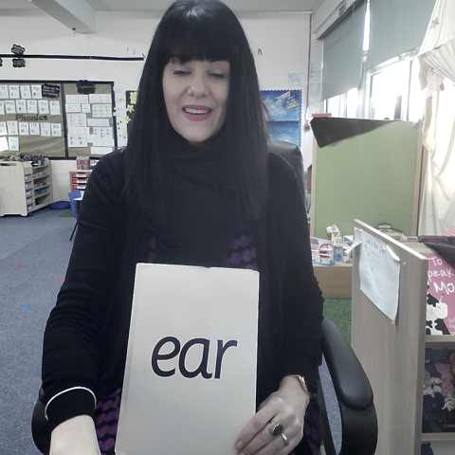
Join in with our sound song.

Slide 19
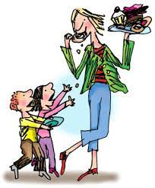
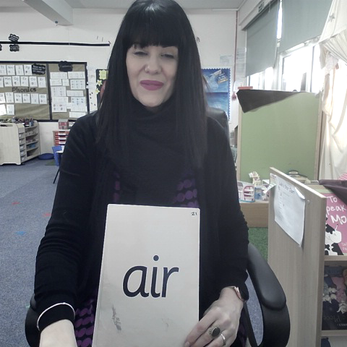
air
That’s not fair!
Action: hold hands on hips.

Slide 20

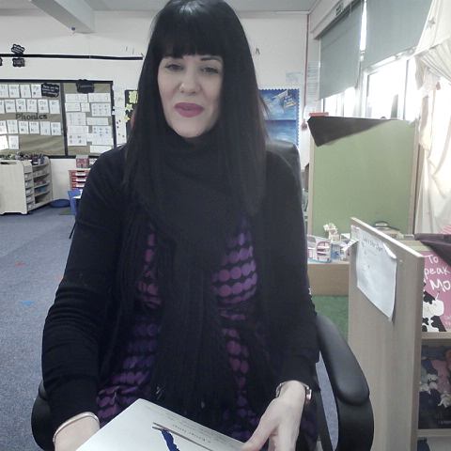
er
Better letter
Action: hold up a letter looking excited.

Slide 21

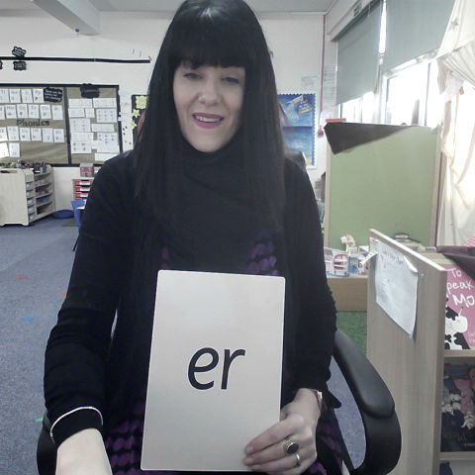

Slide 22
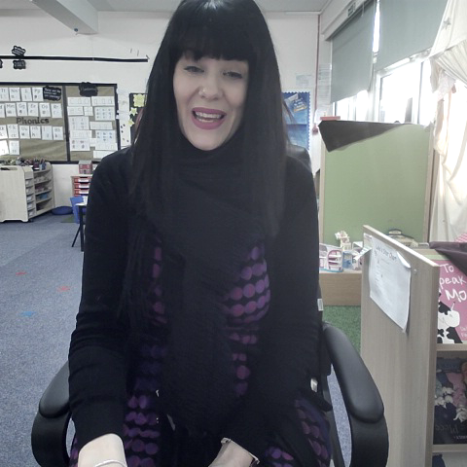
Join in with our sound song.

